Slide 1
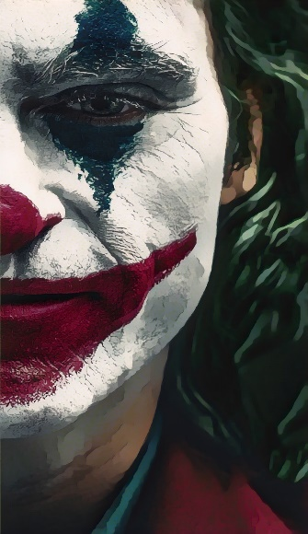
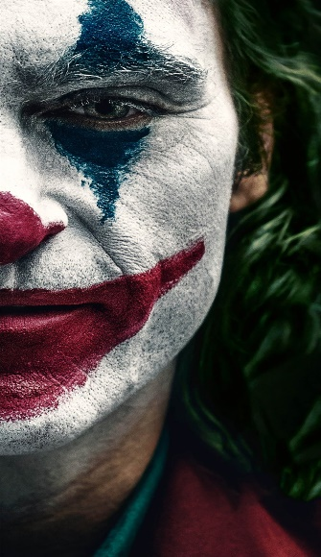
CARTOONISATION
a series of illustrations

Slide 2
Group Members
NIVEDHITHA D P
JAYASHREE S
NAGALLA NIKITHA
KAVIYA S
JANANI SRI J

Slide 3
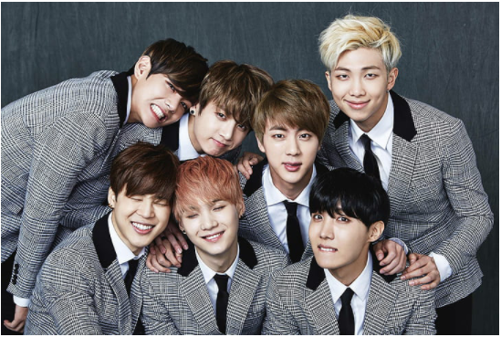
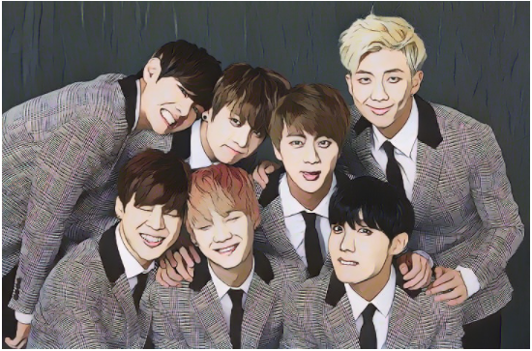
Group Members
LEADER
NIVEDHITHA D P
GROUP MEMBERS
JAYASHREE S
GROUP MEMBERS
JANANI SRI J
GROUP MEMBERS
NAGALLA NIKITHA
GROUP MEMBERS
KAVIYA S

Slide 4
1
Abstract
Content
2
Introduction
3
Literature Survey
4
System Requirements

Slide 5
2
INTRODUCTION

Slide 6

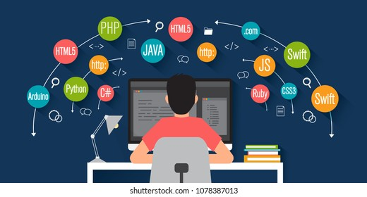
Introduction
Image cartoonization is transformation of real image into an cartoonized image.
To Improve the quality of cartoonized image by giving the image extra clarity, smoothness, and perfect colour code by using machine learning and White box Cartoonization.
It reconstructs a photo into an animation style to provide the best result with maximum efficiency in cartoonization

Slide 7
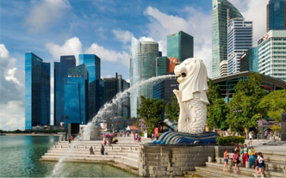
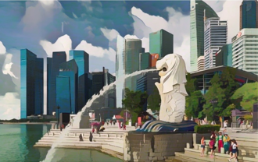
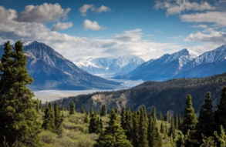
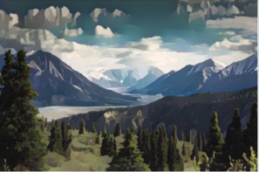
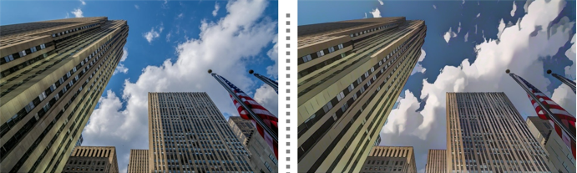
Introduction
A cartoon is a great tool to teach visual literacy which easily holds the attraction of others.
This project highlights cartoonization of both images and videos with minimum quality.
It is developed with some python modulus like OpenCV, numpy , tensor flow.
REAL WORLD IMAGES
CARTOONIZED IMAGES

Slide 8
3
OBJECTIVE

Slide 9
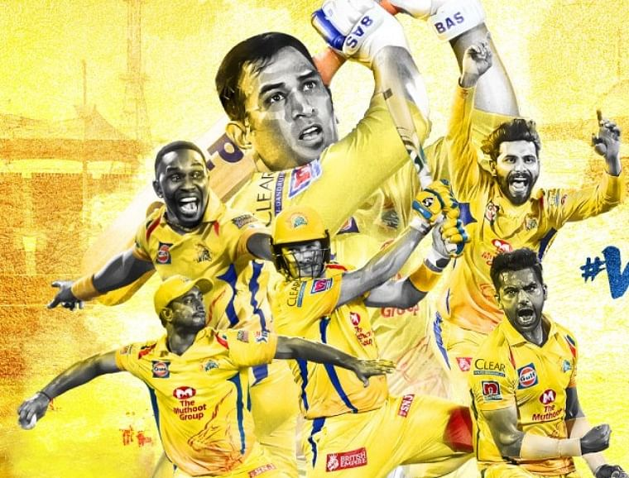
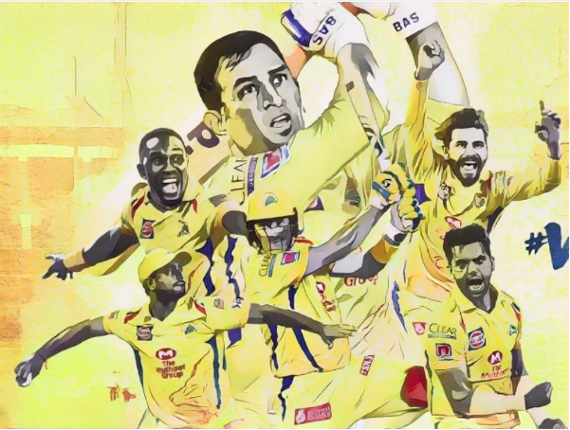

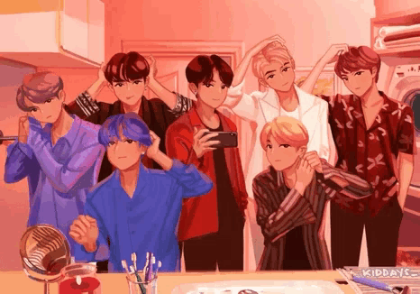
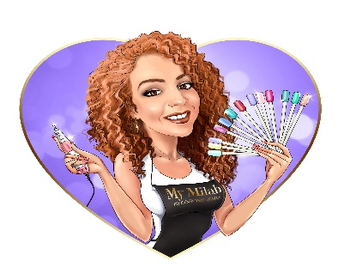
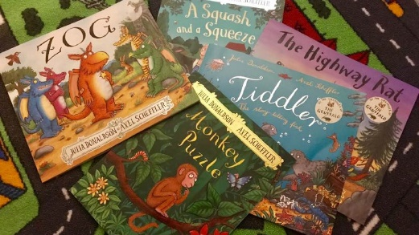
Objective
MOTIVE
To turn real time images and videos into perfect color code cartoons using simple python modules.
Real world images
Cartoonized images
ACCESSIBILITY
accessible in all fields as it can take in any kind of images with multiple sizes.
APPLICATION
applied practically in movie making, animated GIFS, video games, logos, story books, apps, etc.
Animated GIFS
LOGOS
STORY BOOKS

Slide 10
3
SCOPE

Slide 11





cartoons
SCOPE
Cartoons helps the kids to grasp the concepts more easily through Videos, Games, Moral stories makes learning fun.
Education
01
Totally monopolizes the field of entertainment which includes Movies, Shows, Political commentary and visual wit in magazines.
Entertainment
Acts as a medium of communication and makes to understand the concepts easily.
03
Sharing Ideas
02
Cartoons drive the social media through Memes, GIFs makes the conversation interesting and helps in making beautiful memories.
Social Media
05
Business
Plays a premier role in marketing by Posters, Logos, Pamphlets, Banners etc.. Creates a proper finish.
04

Slide 12
4
LITERATURE SURVEY

Slide 13


LITERATURE SURVEY
Mismatch of colour with original image.
Fuzzy cartoon images and vague output.
Highly complicated tools and methods.
Portrait HD images can’t be generated.
Improving quality of image with perfect colour code and efficiency.
Extracting images with more clarity and smoothness.
Reduce complicacy in creation of cartoons by using deep learning concepts like white box cartoonisation.
Production of defined HD image.
Demerits
Updates

Slide 14

LITERTURE SURVEY
It is not applicable for full body image as it concentrates on only selfie cartoons or animes
videos can’t be cartoonised and there can be some color mismatch
We would further improve the quality of the image by giving them perfect color code and make it applicable for a wide range of inputs which include complex images with more efficiency.

Slide 15


LITERTURE SURVEY
It is a black and white cartooned sketch.
It consists of only the outline sketch of the image given, but not the clear detailed sketch of the image.
Our project would consider every component of the images into account and the image would be extracted with extra clarity and smoothness.

Slide 16
LITERTURE SURVEY
Complexity is more in making cartoons by using these tools such as ToonNet, cartoon shader etc...
We would further improve the quality of the image and reduce the complexity of tools by using python and a clear cartoon will be generated without any complex tools.

Slide 17
LITERTURE SURVEY
Using this white box cartoonisation model directly fit the training data decreased its generality and stylization ability, causing bad cases in some situations.
It can be improved by openCV . OpenCV is a cross-platform library used for computer vision. It include applications like video and image capturing and processing.

Slide 18
LITERTURE SURVEY
portrait HD images cannot be produced .
image of living things are more complicated to cartoonify.
Our paper would focus more on generating a portrait of defined HD image.
We would be able to create cartoonised videos also with great efficiency.

Slide 19
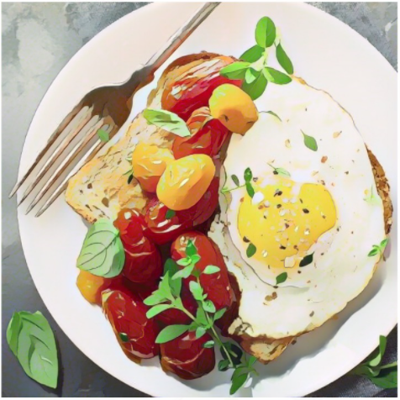
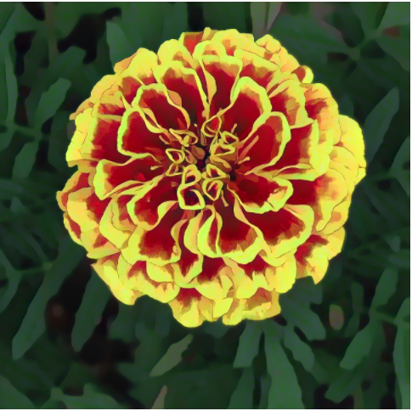
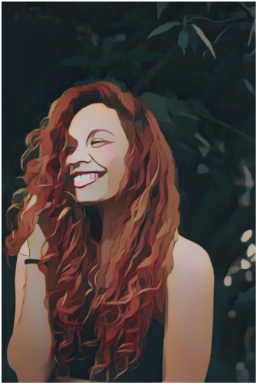
Add your title
Conclusion
Cartoon images and videos from the real time images and videos that we feed into it.
It can be used to create animated gif, comic books etc..

Slide 20
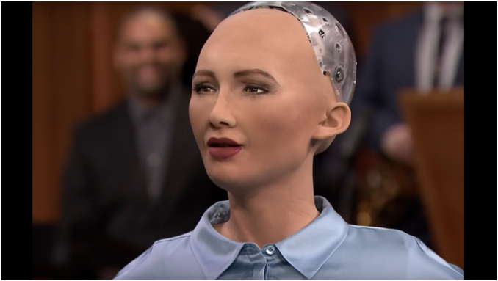
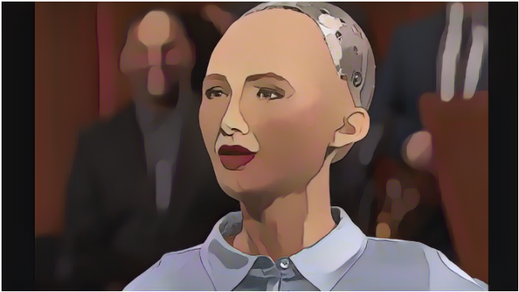
RESULTS
Real time image
Cartooned image

Slide 21
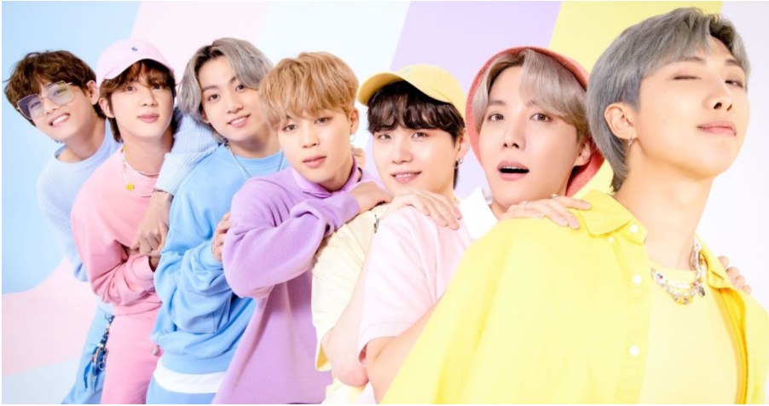
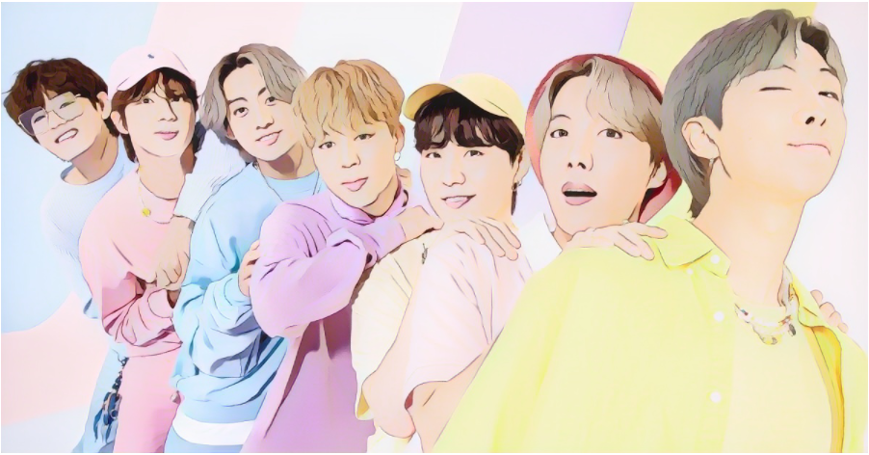
RESULTS
Real time image
Cartooned image

Slide 22
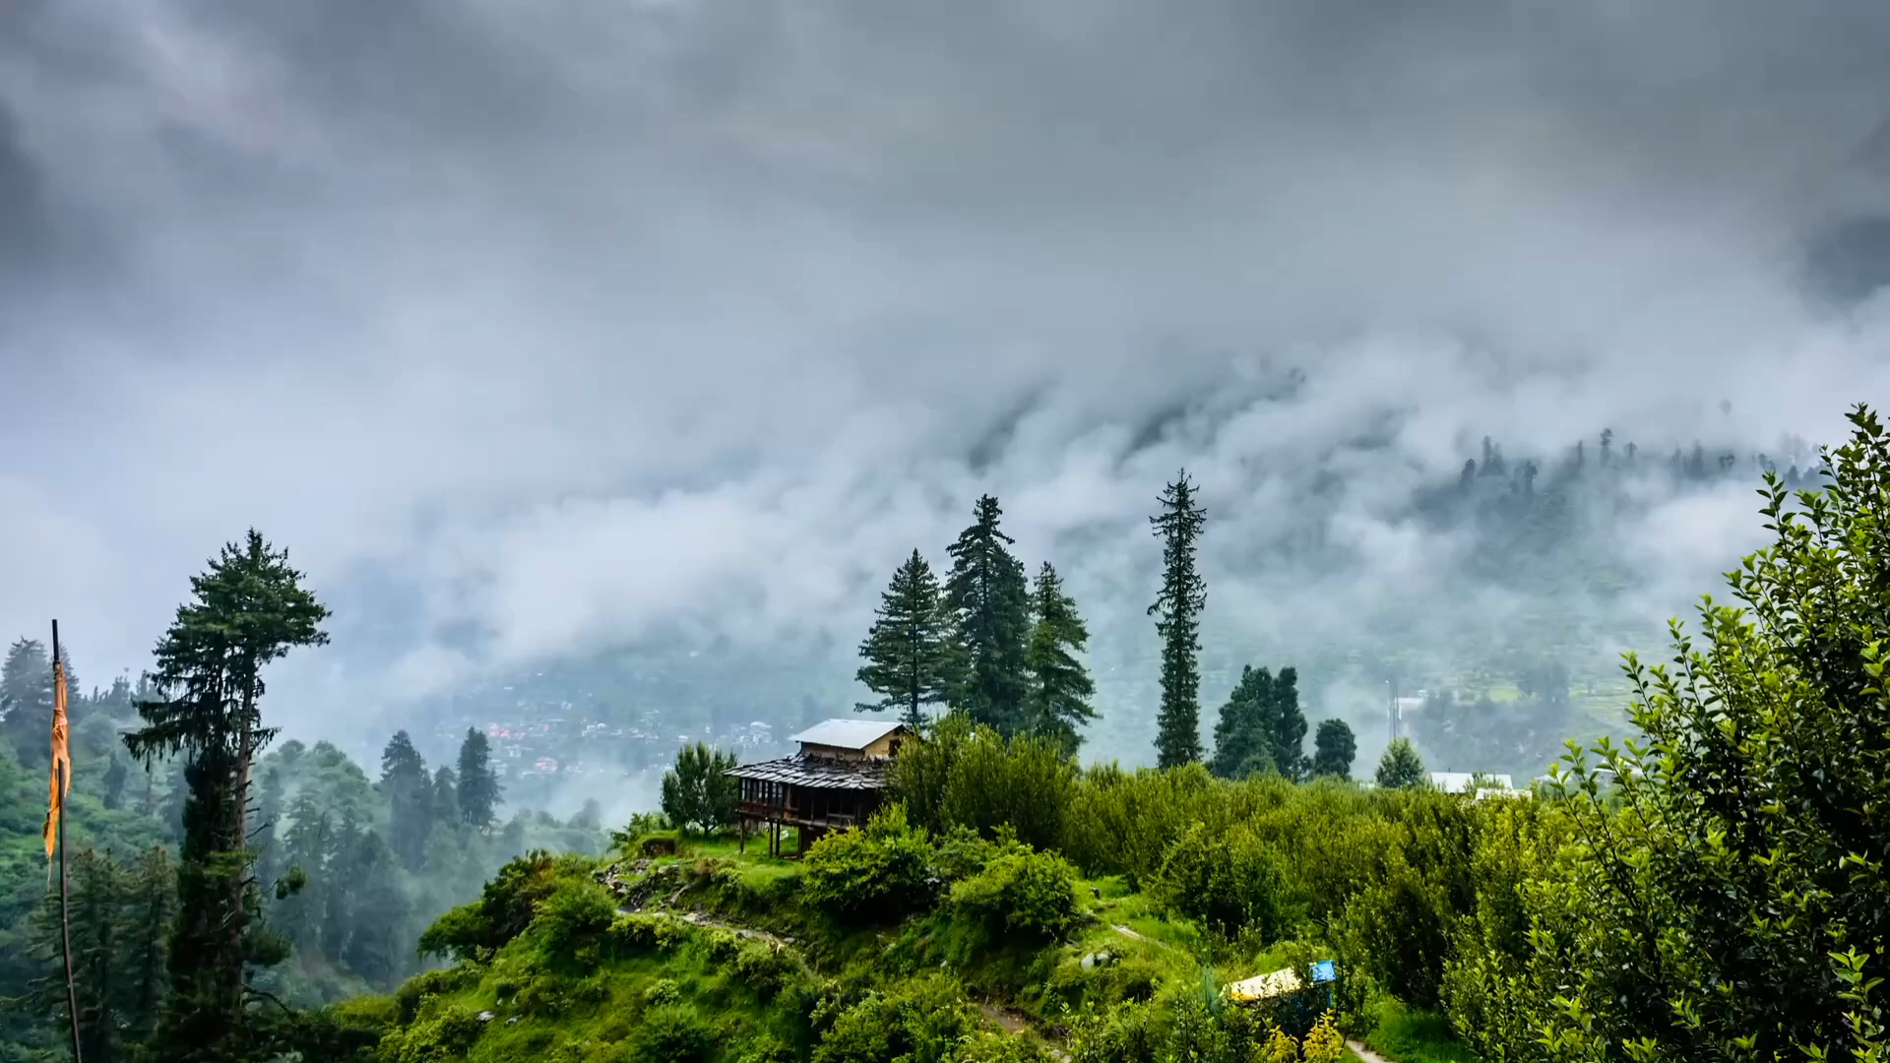
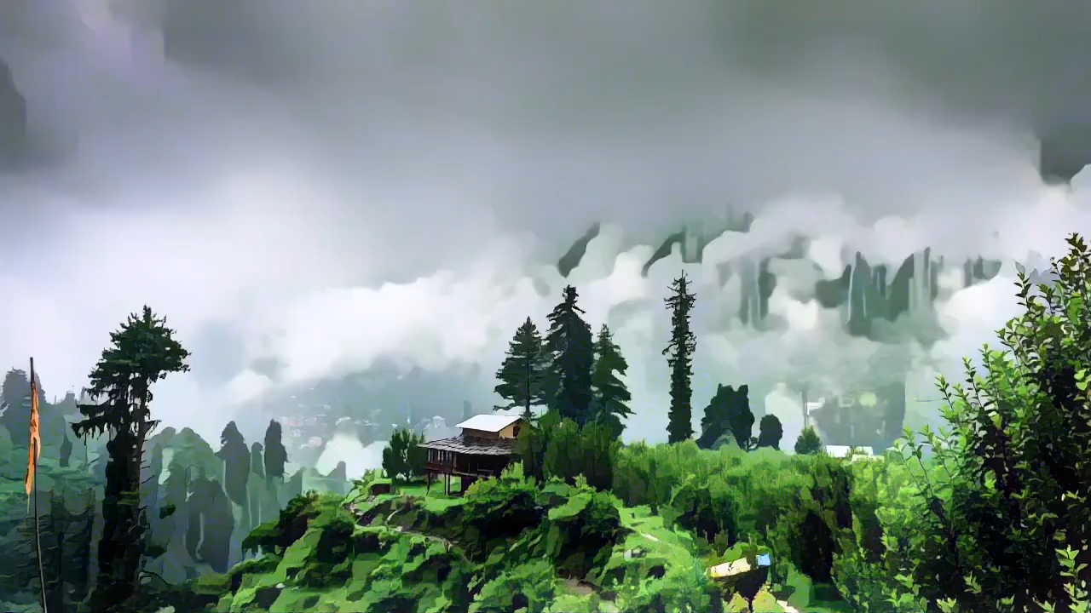
RESULTS
Real time video
Cartooned video

Slide 23


RESULTS
Real time video
Cartooned video

Slide 24
FUTURE ENHANCEMENT
1
2
3
4
5
Remove the blurry from the image so that the cartoon image will be in a shipshape quality.
A web app so that it will be useful be easy for people to access it.
Increase the speed of the system in converting a large number of images and efficiency of the output so that it gives a prime result.
Covert everything to a cartoon that is shown in the camera live by accessing the camera directly.
a high-quality pencil sketch that can be used in commercials and create comical video.

